Slide 1
Understanding the Value of a Business

Slide 2
Equity Value and Enterprise Value

Slide 3
Enterprise Value vs. Equity Value
Enterprise Value = Equity Value + (Total Debt – Cash and Investments)
Enterprise Value
Equity Value
The value of the entire firm
How much you would have to pay to acquire the entire business
All the equity, and all the net debt
Value of only the equity or stock in the firm
How much you would have to pay in order to buy out the residual ownership equity holders own of assets
AKA Market Cap (Remember MC = Shares * Share Price)

Slide 4

Enterprise Value
A quick note: Enterprise Value is approximately equal to:
Cash flow / (Discount Rate– Growth Rate of the company)
We’ll cover this more in-depth next week
But when we talk about EV, try and think about this formula
You’ll see this referenced throughout valuation
Higher growth means higher value (why growth stocks are valued highly)

Slide 5
Enterprise Value vs. Equity Value: Connection to the Balance Sheet
Current Assets
Assets that will be liquid in 12 months
Cash, Short term securities
Inventory
Accounts Receivable
Current Liabilities
Liabilities that will be due within the next 12 months
Short-term debts
Accounts Payable
Non- Current Assets
Assets that are not expected to be liquid in the next 12 months
Factories
Machines
Long-term securities
Shareholder’s Equity
- Common Stock
APIC
Retained Earnings

Slide 6
Intrinsic vs Relative Valuation

Slide 7

Intuition of Valuation
Why do we care about valuation and what will use this for?
Value Investment Theory: Buy Low, Sell High
Attempting to find inefficiencies in the market using our own assumptions or those of the market to exploit unique opportunities
Valuation either intrinsic or relative is the main tool to identify these opportunities

Slide 8
Intrinsic Valuation vs. Relative Valuation
Intrinsic Valuation
Relative Valuation
Intrinsically values the company based off expected future cash flow generation
Works more through theory not the market
Based heavily on model assumptions
Financial Modeling:
DCF, LBO…
Bases the value of the firm off what its peer companies are valued at
Determines this valuation off some “multiple” of a metric
Ex: EBITDA, EBIT, Revenue
Include Comparable Companies, Precedent Transactions, etc…

Slide 9
Intrinsic and Relative in Practice
Value is critical to identifying strong investments, we can think of value in a market in two ways: Intrinsic value and Relative Value. Let’s think about how we would value a Coffee Shop on campus through these 2 lenses
Intrinsic Valuation of Shop X
Relative Valuation of Shop X
Use the company’s historical financials to project revenue down to cash flows
Determine the sum of the present value of those cash flows to arrive at a valuation
Will get more into this next week
Determine what multiples peer firms are trading at
Ex: EV = 8x EV/EBITDA, 6x EV/EBITDA, etc…
Take the min, first quartile, median, etc… of the data set
Apply multiple to company’s metric
EX: Shop X has 100 million EBITDA using the median 7x EV/EBITDA -> Shop X Enterprise Value = 700 million

Slide 10
Types of Intrinsic and Relative Valuation
Intrinsic Valuation
Relative Valuation
Discounted Cash Flow Model
Project out the cash flows, and then discount them to find the PV of a company
Leverage Buy Out Model
Project out cash flows, and debt to find profit assuming cash flows cover debt payments
Comparable (A.K.A Comps) Valuation
Find companies in similar industries and markets, and find what the value the market has placed on that firm
Precedent Transactions Valuation
Find companies in similar industries and markets that have been sold or acquired and find the value they were bought for

Slide 11
Intrinsic Valuation Intuition
Advantages
Disadvantages
Rooted in data and assumptions (manipulate)
Allows for black swans and different cases
Academically correct
All based on assumptions (you could be wrong…)
Overconfidence resulting from assumptions
Prone to error

Slide 12
Relative Valuation Intuition
Advantages
Disadvantages
Bases valuation off real market data
Isn’t heavily reliant on assumption and is dependent heavily on data
Room for interpretation
Ex: A company with a competitive advantage may deserve to trade at the 75 percentile of peers rather than the median
Highly volatile data and sensitive to the current market
Markets are not efficient, and they can always be wrong
Hard to find comparable companies
Often comparable companies are not actual perfect comps

Slide 13
Arriving at a Valuation
Often use both in conjunction to test and get a better understanding of the true value
Bankers and investment firms often calculate both
Can test whether assumptions in DCF are sane
Can also look at comparable company data to arrive at assumption in a DCF
Ex: WACC, Balance Sheet Projections, Debt, Beta, etc…

Slide 14
Comparable Company Analysis

Slide 15
Comparable Valuation (CCA) Method Overview
Step 1: Find the public companies you think are good comparisons to the firm your analyzing
Step 2: Identify metrics and multiples to use (Ex: EV / EBITDA)
Step 3: Find the said metrics and the multiples for all the comparable companies
Step 4: Find and apply the median, 25th or 75th multiples from the data to your company to find the implied Equity or Enterprise Value

Slide 16
Step 1: Finding the Comps for Data
How do we know which companies to select for our comps
3 main factors in deciding how to find the applicable companies to use in your analysis
Geography: Preferably Same Country or Continent
Industry: Same Industry and sector of business
Financial Size: Similar Revenue (Usually Under 1 Billion or b/w 1 – 20 Billion
Ex: Oil and Gas Companies in the United States with over 5 billion in Revenue

Slide 17
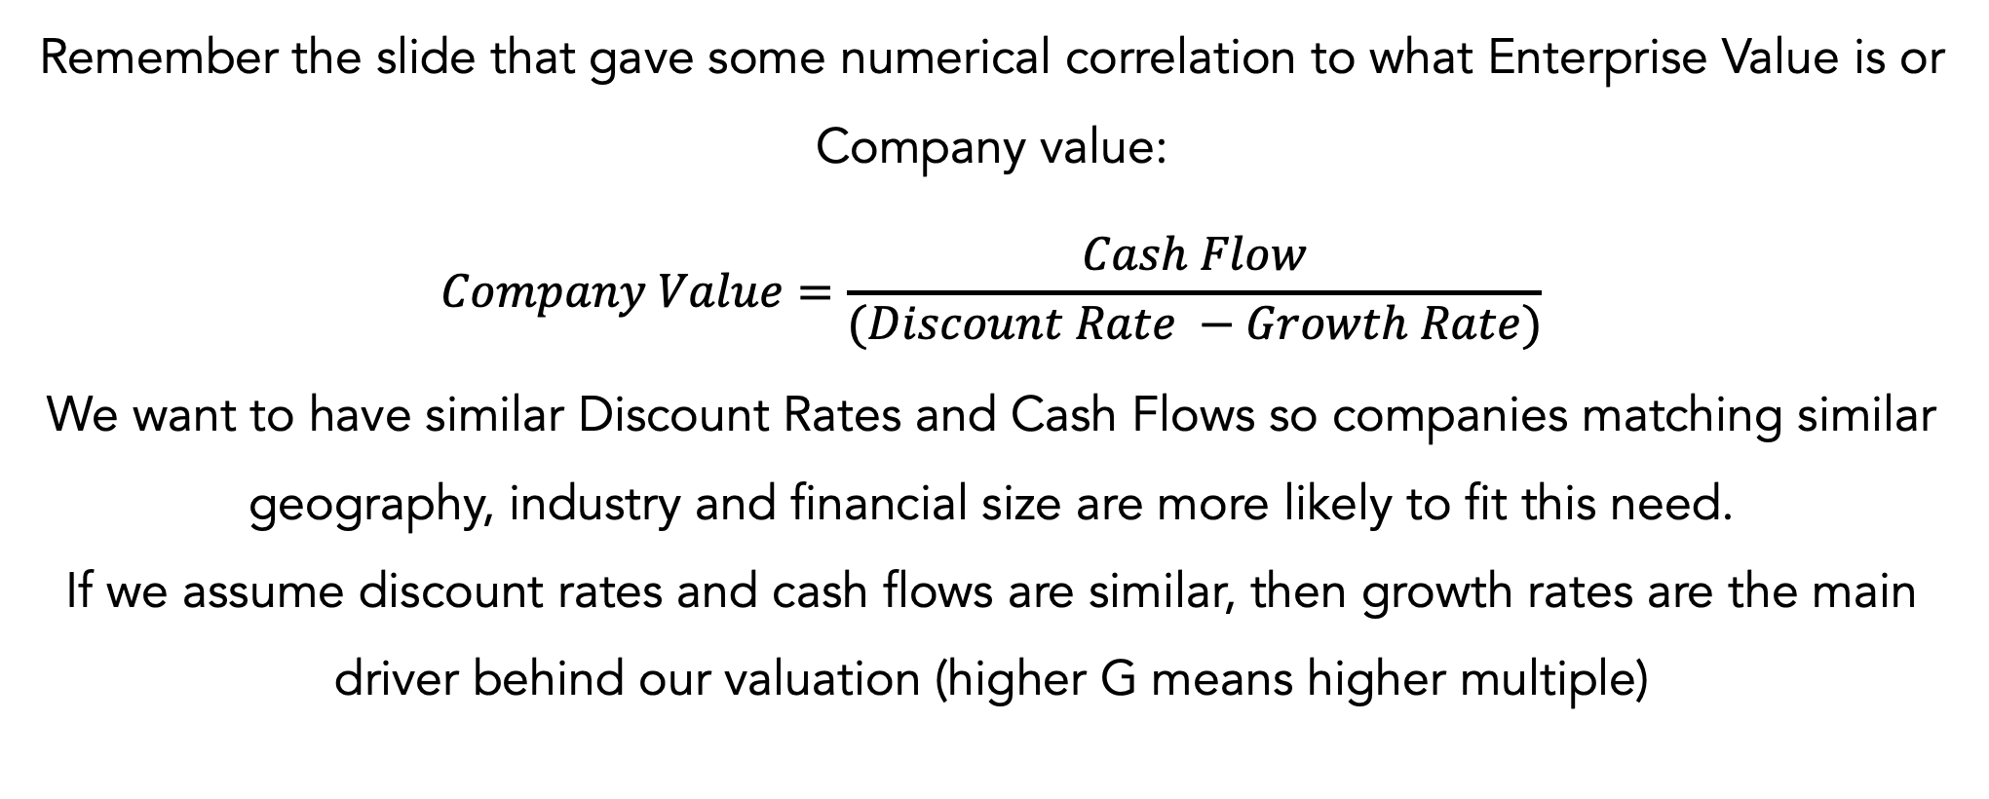
Step 1: Intuition
Why does picking similar companies matter?

Slide 18
Step 2: Find metrics and multiples for the industry
What financial metrics and multiples should we use for our data set?
For all of these you want to use LTM Metrics (Last Twelve Months) because these are the most realistic numbers.
Use a sales-based metric
Revenue, Revenue Growth, EV/Revenue
Use 1 - 2 profitability-based metrics
EV/EBITDA, EBITDA Growth, Net Income, Price/Earnings
Make sure you use the proper X / Y multiple
If you’re calculating equity value you have to use a metric that is only available to equity holders (Net Income and P/E)
If you’re calculating enterprise value you should use a metric that’s available to all investors (EBIT, EBITDA, etc…)

Slide 19
Step 3: Calculate Metrics and Multiples
How do we know which companies to select for our comps
Use simple math to find the metrics
For example, and EV/Revenue multiple would just be EV divided by Revenue.
Tips on finding actual figures:
Finding Equity Value: Just use the Market Cap value
Finding Enterprise Value: Equity Value + Debt + Preferred Stock + NCI – Cash - ST Investments
Just for a quick analysis. Don’t get too caught up on the technicalities

Slide 20
Step 4: Find and Calculate Benchmarks
How do we make sense of this data?
5 Benchmarks that you are seeking to find:
Maximum, 75th Percentile, Median, 25th Percentile and minimum
Then you use your firm’s metrics to find their valuations at each of these benchmarks and project it against the current share price to find likelihood of value
To move from Enterprise to Implied Equity Value just add cash and non-core assets then subtract Debt and Preferred Stock

Slide 21
Complications with CCA
You want to use LTM or TTM (Trailing 12 months and Last Twelve Months) but you might have to edit the financials to get the year mark depending on financial year definition of comps
If you can’t find on Capital IQ or Finviz.com you might have to comb through 10K’s to find the metrics you desire.

Slide 22
Precedent Transactions Method

Slide 23
Precedent Transactions Method Overview
Search for Relevant Transactions
Scrub transactions from the list that do not fit the current situation
Find the valuation multiples that best fit
Analyze valuation multiples and find benchmarks

Slide 24
Step 1: Searching for Relevant Transactions
Find deals that may be applicable
You want to have a wide scope at first to find as many deals as possible
Qualifying Criteria: (like comps)
Industry Classification
Product Mix
Type of company (Public vs. Private)
Geography
Financial Size
Buyer (PE, M&A etc.)

Slide 25
Step 2: Scrub your initial list
Obviously, not all transactions will fit
Now that you have a longer list of qualifying transaction
Looking for fits that have similar business plans and models
Go through and read 10K’s, investor memos, equity research, and other resources to try and decide if close enough or too far.

Slide 26
Step 3: Determine and find Multiples
Figure out which multiples make the most sense to use
May be dependent on industry…
For 95% of the time, if you’re working with a quick analysis
EV/EBITDA 🡪 Hot on the street
EV/Revenue
Like Comps, go through and find 5 benchmarks
Max, 75th Percentile, Median, 25th Percentile, Min

Slide 27
Step 4: Apply Benchmarks to firm in question
Multiply the multiple by the firm’s financial metrics and find estimated valuations
High: 7x EV/EBITDA
$6 M TTM EBITDA
High Valuation: $42 Million
High: 3.5x EV/EBITDA
Floor Valuation: $21 Million

Slide 28
Financial Statement Analysis

Slide 29
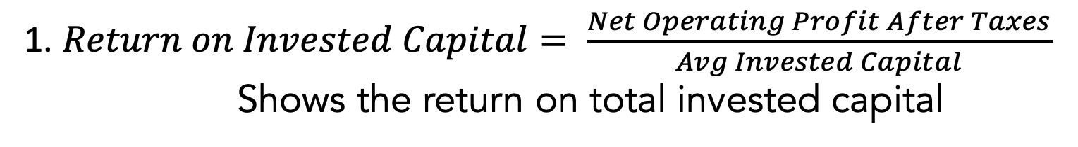


How to calculate Return on Capital
3 main ways to find return on capital
Note: Use average in calculations because balance sheet is at a point in time and income statement is over a period of time

Slide 30
Dupont Analysis – Breaking Down ROA
Profit Margin
Total Asset Turnover
Measure of productivity
How much revenue is the company converting into profit
Measure of efficiency
For every dollar of assets invested how many dollars of revenue are being generated
Net Income
Revenue
Revenue
Avg Total Assets
Profit Margin
Asset Turnover

Slide 31
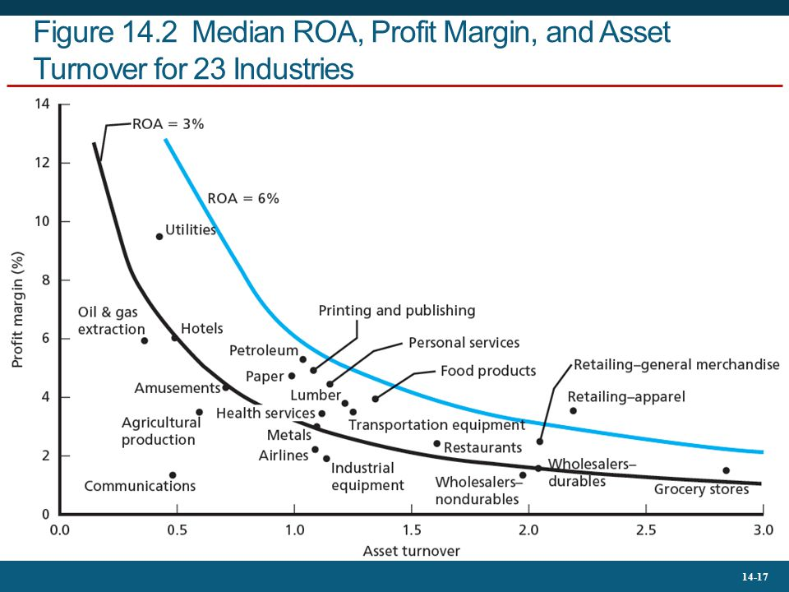
Profit Margin vs Total Asset Turnover
Profit Margin and Total Asset Turnover are inversely correlated
High Profit Margin = Low Total Asset Turnover and Vice Versa
Specific companies can improve their Returns by targeting a higher PM or TAT

Slide 32
Dupont Analysis – Breaking Down ROE
ROA (Profit Margin * Asset Turnover)
Financial Leverage
First part is the ROA Formula
Amplifies returns (ROA)
One measurement of how leveraged a company is
Net Income
Revenue
Revenue
Ave Total Assets
Ave Total Assets
Avg BV of Equity
Profit Margin
Asset Turnover
Leverage

Slide 33
Dupont Analysis – Breaking Down ROIC
ROIC is a variation of ROA that looks at returns on net operating assets
Net Operating Margin
Return on Operating Assets
Looks at how much profit just the operations of the business generate
Analyzes how much revenue operating assets are generating
NOPAT
Revenue
Revenue
Ave Invested Capital

Slide 34
Breaking down Return on Invested Capital: NOPAT
Why do we use NOPAT instead of Net Income?
- Excludes Interest Expenses…
- Unlike ROE or ROA, is not impacted by the leverage of business
- NOPAT gives us the clearest picture of profit created by assets
- Excludes Taxes and Includes Interest Expense
Revenue
Cost of Goods Sold
Gross Profit
Sales Goods & Administration
Depreciation & Amortization
Profits to Distribute
Operating Income Profit
Interest Expense
Tax Expense
Debt Owner hold on Profits Produced
Net Income
Gov’t hold on Profits Produced
Equity Holders Hold on Profit

Slide 35
Breaking Down ROIC: Invested Capital
Debt Markets
Breaking Down Invested Capital
Step 1: Total Debt represents all the capital sourced from debt markets
Step 2: BV of Equity represents the capital sourced from equity markets
Step 3: Subtracting Cash and Assets accounts for double counted cash (could pay down debt)
Firm
Equity Markets

Slide 36



What goes into creating a stronger ROIC?
Return On Invested Capital
High Margin, Low Turnover
Companies can boost their ROIC by either improving profit margin or improving inventory turnover. They can rarely do one without sacrificing the other
High Turnover, Low Margin

Slide 37
Intrinsic Value Compounding rate
Intrinsic Value Compounding Rate = ROIC * Reinvestment Rate
A company can boost its growth by reinvesting into itself
A high ROIC is nice but can be accelerated by reinvesting into itself and capturing the returns
Compounding is powerful and can deliver returns in surplus to shareholders

Slide 38
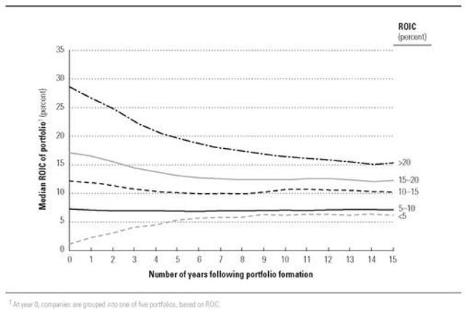
Examining Returns on Capital over time
Overtime, Return on Invested Capital will revert to the mean ROIC of its’ industry
If an industry is profitable firms will enter the market and bring returns down (Econ 101)
Competitive advantages can allow company to maintain above average ROIC in the long run

Slide 39
Competitive Strategy

Slide 40
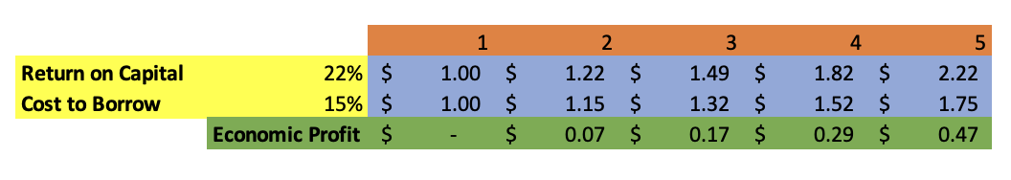
The Goal of All Companies in a Capital Market
What is Economic Profit: Comparing the return on investments and the opportunity cost of using money
Economic Profit
Revenue – Explicit Costs
Opportunity Costs
Return On Capital: “Accounting Profits”, Are assets good at making $
Cost of Capital: Profits we gave up by locking up cash

Slide 41
REVENUE
EXPLICIT COSTS
COST OF CAPITAL
Revenue Levers
Revenue
Cost of Debt
Profit Margin
COGS
Cost of Capital
SG&A
Volume Sold
D&A
R&D

Slide 42
Porters 5 Forces: Competitive Fit and Analysis
Bargaining Power of Buyers
Threat of New Entrants
f
Industry Rivalry
f
f
f
Bargaining Power of Suppliers
Threat of Substitutes

Slide 43
Force 1: Industry Rivalry
Analyzing the Competition of an Industry
Things to think about
Number of Competitors
Strength of Competitors
Infrastructure of the Industry

Slide 44
Force 2: Bargaining Power of Buyers
Analyzing the strength of buyers relative to sellers
Things to think about
Do suppliers outnumber buyers in the industry?
Is it easy/cheap for a buyers to switch to another seller?
How big are customer orders (can they dictate terms to you)?

Slide 45
Force 3: Bargaining powers of Suppliers
Analyzing how easy it is for your suppliers to raise prices
Things to think about
How many potential suppliers do you have?
How expensive would it be for you to switch to another supplier?
How unique/specialized is the product they are providing you with?

Slide 46
Force 4: Threat of New Entrants
Are there barriers to entry in this market? How easy is it for competitors to join the market?
Think about
Extended network to be competitive?
High Capital Requirements?
Is the sector tightly regulated?
Do new entrants come and go regularly?

Slide 47
Force 5: Threat of Substitutes
What products can be used in place of the goods or services you provide?
Things to think about
How unique/differentiated is your product?
How close is the substitute (I.e. can customers switch without noticing a major difference)?
How inelastic is consumer demand for your product?

Slide 48
Economic Moats vs. Competitive Advantages
Both Moats and Competitive Advantages are qualitative aspects of businesses that help offer them protection against the minimization of their ROIC.
Competitive Advantages will fade over time in theory
Economic Moats will be longstanding advantages that companies could thrive off

Slide 49
Examples of Economic Moats: Intangible Assets
Best thought of as intangibles that will justify a premium price or protect a customer base:
Brand Names: Coca Cola, Porsche
Trade Secrets: Krabby Patty Secret Recipe
Culture: Salesforce Hawaiian Fridays

Slide 50
Examples of Economic Moats: Switching Costs
Capital or Opportunity costs that would result from switching brands
Software: iCloud and Apple, MS Office Suite
Manufacturing: Supply chains built from relationships

Slide 51
Examples of Economic Moats: Network Effects
The product gains more value as more users join the network, less incentive to join the newer networks
Social Media: Tinder, Hinge, Instagram
3rd party sales: eBay, Amazon
Exchanges: NASDAQ
Ride Hailing: Uber and Lyft

Slide 52
Examples of Economic Moats: Cost Advantage
Advantages that give firms the opportunity to have lower expenses and therefore create an incentive for customers to buy low-cost product
Economies of scale:
Walmart, Amazon, TSM
Low-cost resource base
Easier access to distribution channels
Cheaper patented technology

Slide 53
Examples of Economic Moats: Efficient Scale
Company has a stronghold on a market that can only hold a limited number of players
Sports: NBA, NFL, NHL
Niche Markets: Natural Resources, Banks, Defense Contractors

Slide 54
Questions

